Slide 1


Unity Workshop
GameGig 2018
Huw Bowles & Tom Read-Cutting

Slide 2
Agenda
High level Unity orientation
A few words on one button mechanics
(Attempt to) create a simple game

Slide 3
One button mechanics
Are hard

Slide 4

Tiny Wings

Slide 5
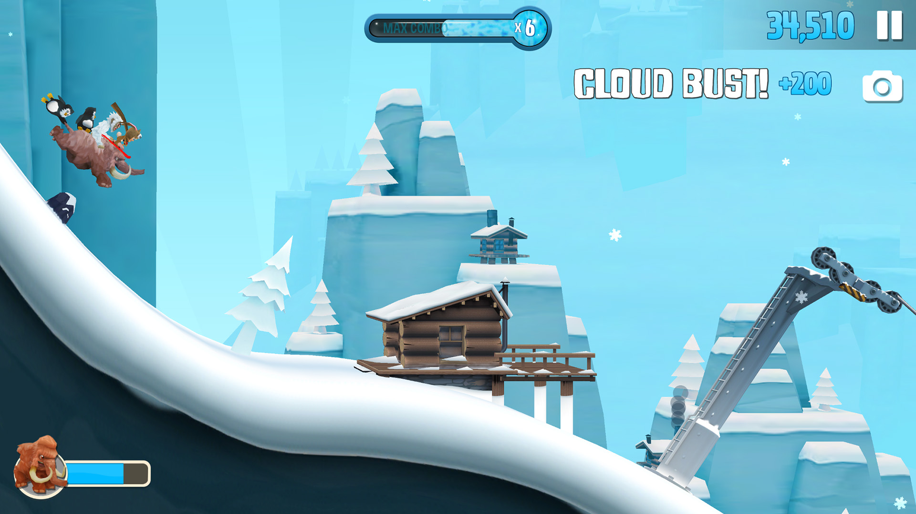
Ski Safari

Slide 6
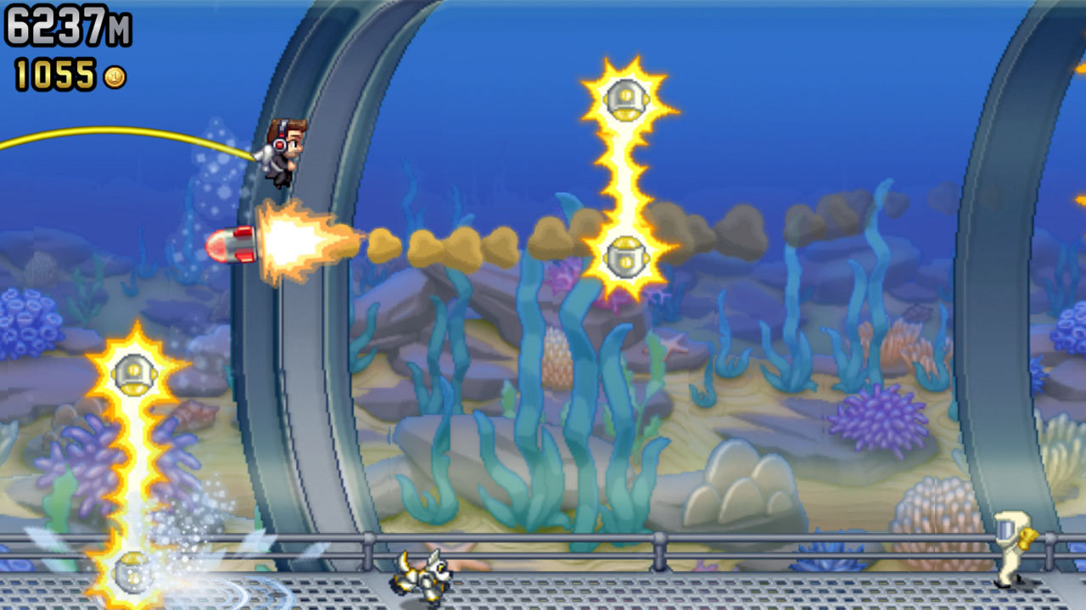
Jetpack Joyride

Slide 7
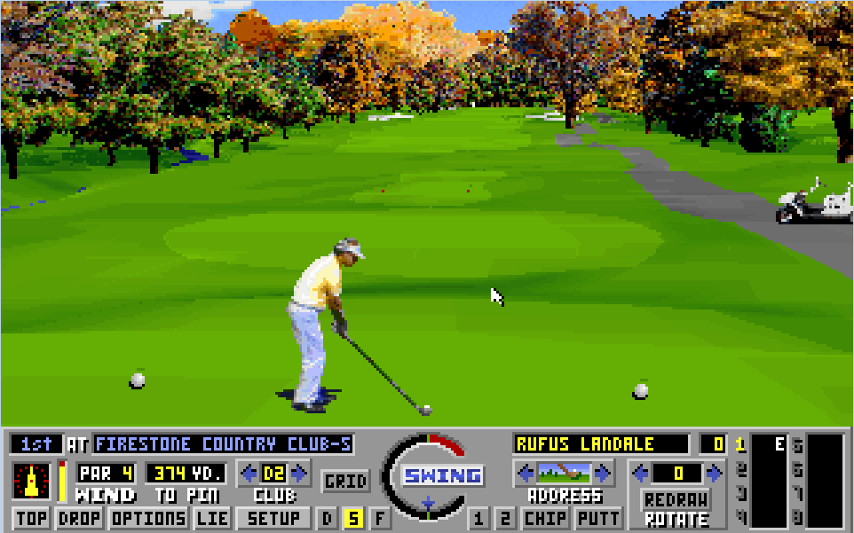
Links

Slide 8
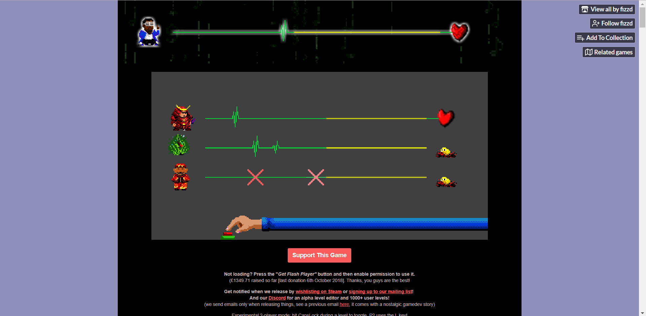
Rhythm Doctor

Slide 9
Resources
Unity
https://unity3d.com/learn/tutorials
www.google.com
Assets
“Standard Assets” on Unity Asset Store
TurboSquid
One button ideas
https://itch.io/jam/one-button-to-rule-all-jam
https://www.gamasutra.com/view/feature/130728/one_button_games.php

